Slide 1
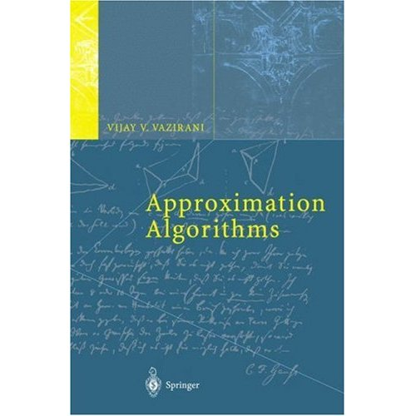
Introduction to
Approximation
Algorithms
Lecture 12: Mar 1

Slide 2
NP-completeness
We have seen many polynomial time solvable optimization problems.
e.g. maximum matching, min-cost flow, minimum cut, etc.
However, there are much more optimization problems that we do not know how to solve in polynomial time.
e.g. traveling salesman, graph colorings, maximum independent set, set cover, maximum clique, maximum cut, minimum Steiner tree, satisfiability, etc.

Slide 3
Vertex Cover
Vertex cover: a subset of vertices which “covers” every edge.
An edge is covered if one of its endpoint is chosen.
The Minimum Vertex Cover Problem:
Find a vertex cover with minimum number of vertices.

Slide 4
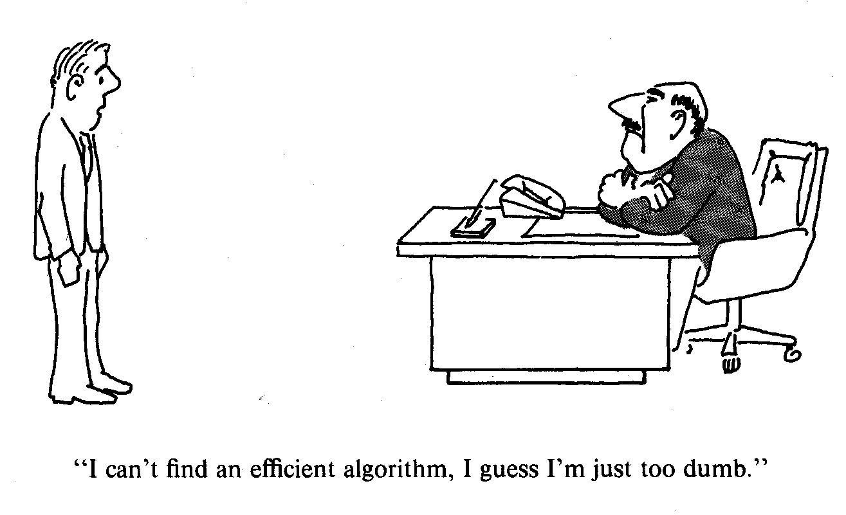
NP-completeness

Slide 5
NP-completeness
NP (Non-deterministic polynomial time):
A class of decision problems whose solutions can be “verified” in polynomial time.
For each “yes” instance, there is a proof that can be checked in polynomial time.
Decision problem for vertex cover: Is there a vertex cover of size at most k?
For each “yes” instance of the vertex cover problem,
the proof is just a set of k vertices which cover all the edges.
Given this set, one can easily check whether this is a vertex cover.
Examples of NP problems: traveling salesman, graph colorings,
maximum independent set, set cover, maximum clique,
maximum cut, minimum Steiner tree, satisfiability, etc.

Slide 6

NP-completeness
(Cook 1970) If one can solve satisfiability in polynomial time, then one can solve all problems in NP in polynomial time.
We say satisfiability is an NP-complete problem.
Examples of NP-complete problems: traveling salesman, graph colorings,
maximum independent set, set cover, maximum clique,
maximum cut, minimum Steiner tree, satisfiability, etc.

Slide 7
Examples of NP-complete problems
Summary of some NPc problems
SAT
3SAT
Maximum cut
Graph coloring
Vertex cover
Independent set
Set cover
Maximum
clique size
Minimum
Steiner tree
Hamiltonian
cycle
find more NP-complete problems in
http://en.wikipedia.org/wiki/List_of_NP-complete_problems

Slide 8
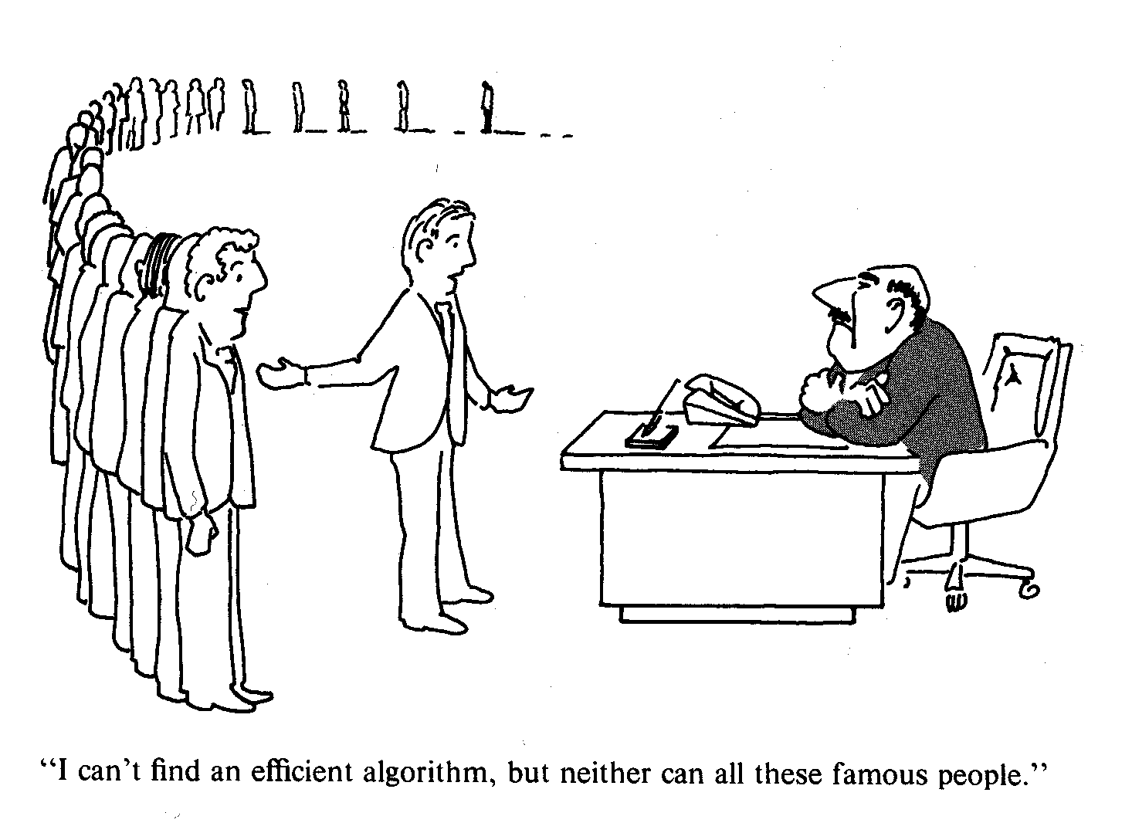
NP-completeness

Slide 9
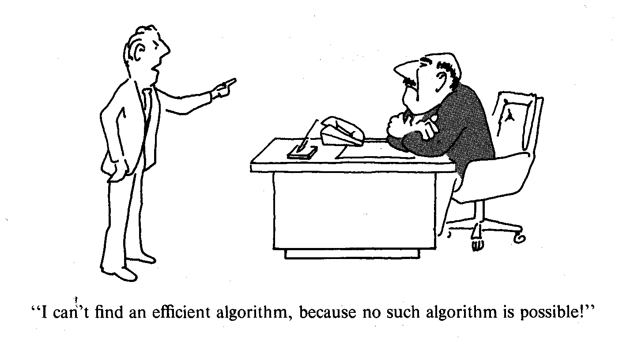
NP-completeness
Million dollar open problem: Is P=NP?

Slide 10

NP-completeness
Why people believe that P NP?
I can appreciate good music (being able to verify solutions)
doesn’t mean that I can compose good music (to find solutions).
(from wikipedia) "Proof by contradiction. Assume P = NP. Let y be a proof that P = NP. The proof y can be verified in polynomial time by a competent computer scientist, the existence of which we assert. However, since P = NP, the proof y can be generated in polynomial time by such computer scientists. Since this generation has not yet occurred (despite attempts by such computer scientists to produce a proof), we have a contradiction."

Slide 11
NP-completeness
!
Do your best then.

Slide 12
Some Alternatives
Special graph classes
e.g. vertex cover in bipartite graphs, perfect graphs.
Fixed parameter algorithms
find a vertex cover of size k efficiently for small k.
Average case analysis
find an algorithm which works well on average.
Approximation algorithms
find an algorithm which return solutions that are
guaranteed to be close to an optimal solution.

Slide 13
Approximation Algorithms
Key: provably close to optimal.
Let OPT be the value of an optimal solution,
and let SOL be the value of the solution that our algorithm returned.
Additive approximation algorithms: SOL <= OPT + c for some constant c.
Very few examples known: edge coloring, minimum maximum-degree spanning tree.
Constant factor approximation algorithms: SOL <= cOPT for some constant c.
Many more examples known.

Slide 14
Vertex Cover: Greedy Algorithm 1
Idea: Keep finding a vertex which covers the maximum number of edges.
Greedy Algorithm 1:
Find a vertex v with maximum degree.
Add v to the solution and remove v and all its incident edges from the graph.
Repeat until all the edges are covered.
How good is this algorithm?

Slide 15
Vertex Cover: Greedy Algorithm 1
OPT = 6, all red vertices.
SOL = 11, if we are unlucky in breaking ties.
First we might choose all the green vertices.
Then we might choose all the blue vertices.
And then we might choose all the orange vertices.

Slide 16
Vertex Cover: Greedy Algorithm 1
Not a constant factor
approximation algorithm!
k! vertices of degree k
Generalizing
the example!
k!/k vertices of degree k
k!/(k-1) vertices of degree k-1
k! vertices of degree 1
OPT = k!, all top vertices.
SOL = k! (1/k + 1/(k-1) + 1/(k-2) + … + 1) ≈ k! log(k), all bottom vertices.

Slide 17
Vertex Cover: Greedy Algorithm 2
In bipartite graphs, maximum matching = minimum vertex cover.
In general graphs, this is not true.
How large can this gap be?

Slide 18
Vertex Cover: Greedy Algorithm 2
Fix a maximum matching. Call the vertices involved black.
Since the matching is maximum, every edge must have a black endpoint.
So, by choosing all the black vertices, we have a vertex cover.
SOL <= 2 * size of a maximum matching

Slide 19
Vertex Cover: Greedy Algorithm 2
What about an optimal solution?
Each edge in the matching has to be covered by a different vertex!
OPT >= size of a maximum matching
So, OPT <= 2 SOL, and we have a 2-approximation algorithm!

Slide 20
Vertex Cover
Approximate min-max theorem:
Maximum matching <= minimum vertex cover <= 2*maximum matching
Major open question: Can we obtain a 2-approximation algorithm?
Hardness result: It is NP-complete even to approximate within a factor of 1.36!!

Slide 21
Topics to be Covered
A diverse set of techniques.
Combinatorial arguments: TSP, Steiner trees, multiway cut
Dynamic programming: knapsack
Iterative rounding: network design problem
Randomized rounding: congestion minimization, set cover
Semidefinite programming: maximum cut
Primal-dual algorithms? Greedy algorithms?
A popular topic: graph partitioning problems.
Multicut, sparsest cut, metric labeling, correlation clustering, etc.

Slide 22
Approximation Algorithms: Combinatorial Approaches
Lecture 13: March 2

Slide 23
The Hamiltonian Path Problem
Hamiltonian Path Problem:
Given an undirected graph, find a cycle visiting every vertex exactly once.
Eulerian Path Problem:
Given an undirected graph, find a walk visiting every edge exactly once.
Notice that in a walk some vertices may have been visited more than once.
The Eulerian Path problem is polynomial time solvable.
A graph has an Eulerian path if and only if every vertex has an even degree.
The Hamiltonian Path problem is NP-complete.

Slide 24
The Hamiltonian Path Problem
Application: Seating assignment problem:
Given n persons and a big round table of n seats, each pair of persons may like each other or hate each other. Can we find a seating assignment so that everyone likes his/her neighbors (only two neighbors)?
Construct a graph as follows. For each person, create a vertex. For each pair of vertices, add an edge if and only if they like each other. Then the problem of finding a seating assignment is reduced to the Hamiltonian path problem.

Slide 25
The Traveling Salesman Problem
Traveling Salesman Problem (TSP):
Given a complete graph with nonnegative edge costs,
Find a minimum cost cycle visiting every vertex exactly once.
Given a number of cities and the costs of traveling from any city to any other city, what is the cheapest round-trip route that visits each city exactly once and then returns to the starting city?
One of the most well-studied problem in combinatorial optimization.

Slide 26
NP-completeness of Traveling Salesman Problem
Traveling Salesman Problem (TSP):
Given a complete graph with nonnegative edge costs,
Find a minimum cost cycle visiting every vertex exactly once.
Hamiltonian Path Problem:
Given an undirected graph, find a cycle visiting every vertex exactly once.
The Hamiltonian path problem is a special case of the Traveling Salesman Problem.
For each edge, we add an edge of cost 1.
For each non-edge, we add an edge of cost 2.
If there is a Hamiltonian path, then there is a cycle of cost n.
If there is no Hamiltonian path, then every cycle has cost at least n+1.

Slide 27
Inapproximability of Traveling Salesman Problem
Theorem: There is no constant factor approximation algorithm for TSP,
unless P=NP.
Idea: Use the Hamiltonian path problem.
For each edge, we add an edge of cost 1.
For each non-edge, we add an edge of cost 2
nk.
If there is a Hamiltonian path, then there is a cycle of cost n.
If there is no Hamiltonian path, then every cycle has cost greater than nk.
So, if you have a k-approximation algorithm for TSP,
one just needs to check if the returned solution is at most nk.
If yes, then the original graph has a Hamiltonian path.
Otherwise, the original graph has no Hamiltonian path.

Slide 28
Inapproximability of Traveling Salesman Problem
Theorem: There is no constant factor approximation algorithm for TSP,
unless P=NP.
This type of theorem is called “hardness result” in the literature.
Just like their names, usually they are very hard to obtain.
If there is a Hamiltonian path, then there is a cycle of cost n.
If there is no Hamiltonian path, then every cycle has cost greater than nk.
The strategy is usually like this.
This creates a gap between yes and no instances.
The bigger the gap, the problem is harder to approximate.

Slide 29
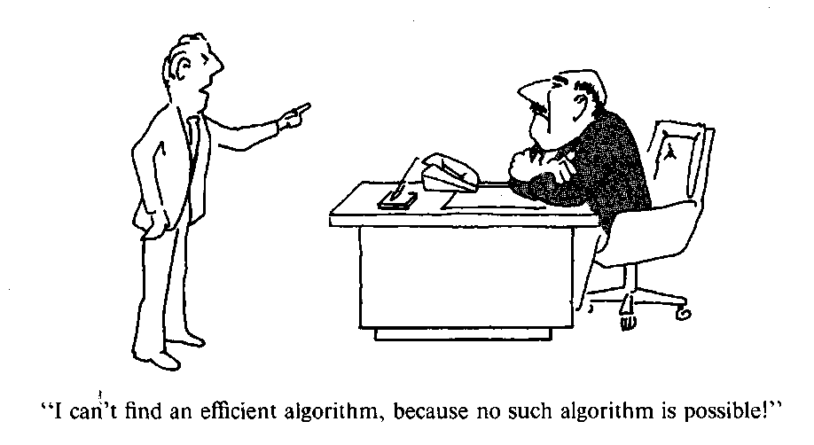
Approximation Algorithm for TSP
There is no constant factor approximation algorithm for TSP,
what can we do then?
Observation: in real world situation, the costs satisfy triangle inequality.
a
a + b ≥ c
c
For example, think of cost of an edge
as the distance between two points.
b

Slide 30
Approximation Algorithm for Metric TSP
Metric Traveling Salesman Problem (metric TSP):
Given a complete graph with edge costs satisfying triangle inequalities,
Find a minimum cost cycle visiting every vertex exactly once.
1
First check the bad example.
nk
This violates triangle inequality!
1
How could triangle inequalities help in finding approximation algorithm?

Slide 31
Lower Bounds for TSP
What can be a good lower bound to the cost of TSP?
A tour contains a matching.
Let OPT be the cost of an optimal tour, since a tour contains two matchings,
the cost of a minimum weight perfect matching is at most OPT/2.
A tour contains a spanning tree.
So, the cost of a minimum spanning tree is at most OPT.

Slide 32
Spanning Tree and TSP
Let the thick edges have cost 1,
And all other edges have cost greater than 1.
So the thick edges form a minimum spanning tree.
But it doesn’t look like a Hamiltonian cycle at all!
Edge cost at most 2
Consider a Hamiltonian cycle.
The costs of the edges which are not in the
minimum spanning tree might have very high costs.
Not really! Each such edge has cost at most 2
because of the triangle inequality.

Slide 33
Spanning Tree and TSP
a
e
b
c
d
Strategy: Construct the TSP tour from a minimum spanning tree.
Use the edges in the minimum spanning tree as many as possible.
The center vertex already has degree 2, skip to the next vertex.
Cost of a minimum spanning tree
Cost = e + a
+ a + b
+ b + c
+ c + d
+ d + e
= 2a + 2b + 2c + 2d + 2e = 2(a +b + c + d + e)
MST ≤ OPT
SOL ≤ 2MST
+
SOL ≤ 2OPT

Slide 34
Spanning Tree and TSP
How to formalize the idea of “following” a minimum spanning tree?

Slide 35
Spanning Tree and TSP
How to formalize the idea of “following” a minimum spanning tree?
Key idea: double all the edges and find an Eulerian tour.
This graph has cost 2MST.

Slide 36
Spanning Tree and TSP
How to formalize the idea of “following” a minimum spanning tree?
Key idea: double all the edges and find an Eulerian tour.
This graph has cost 2MST.

Slide 37
Spanning Tree and TSP
Strategy: shortcut this Eulerian tour.

Slide 38
Spanning Tree and TSP
By triangle inequalites, the shortcut tour is not longer than the Eulerian tour.
Each directed edge is used exactly once in the shortcut tour.

Slide 39
A 2-Approximation Algorithm for Metric TSP
(Metric TSP – Factor 2)
Find an MST, T, of G.
Double every edge of the MST to obtain an Eulerian graph.
Find an Eulerian tour, T*, on this graph.
Output the tour that visits vertices of G in the order of
their first appearance in T*. Let C be this tour.
(That is, shortcut T*)
Analysis:
cost(T) ≤ OPT (because MST is a lower bound of TSP)
cost(T*) = 2cost(T) (because every edge appears twice)
cost(C) ≤ cost(T*) (because of triangle inequalities, shortcutting)
So, cost(C) ≤ 2OPT

Slide 40
Better approximation?
There is a 1.5 approximation algorithm for metric TSP.
Hint: use a minimum spanning tree and a maximum matching
(instead of double a minimum spanning tree).
Major open problem: Improve this to 4/3?
An aside: hardness result is not an excuse to stop working,
but to guide us to identify interesting cases.
Just for fun: can we design an approximation algorithm for the seating assignment problem?

Slide 41
Minimum Steiner Tree
The Minimum Steiner Tree Problem:
Given an undirected graph G with nonnegative edge costs and whose vertices are partitioned into two sets, required vertices and Steiner vertices, find a minimum cost tree in G that contain all the required vertices and any subset of the Steiner vertices.

Slide 42





Applications
Computer networks
VLSI circuit design

Slide 43
Special Cases
Only two required vertices,
just a shortest path.
Every vertex is required,
just a minimum spanning tree.
The general problem is NP-complete.

Slide 44
Useless Edges
We must use Steiner vertices in order to construct a good solution, because edges connecting required vertices could be very expensive (or even don’t exist).
2
10
1
2
10
1
1
10
2
Would I ever use an edge of weight 10 (an expensive edge)?
The purpose of using such an edge is to connect two required vertices,
but we can always use a path of length 2 (which passes through
the Steiner vertices and has a total cost of 2) for the same purpose!

Slide 45
Metric Closure
2
10
1
2
10
1
1
10
2
In general, we can always replace the cost of an edge
by the cost of a cheapest (shortest) path.
We call the resulting graph the metric closure of the original graph.

Slide 46
Metric Closure
Claim. In the metric closure, the edge costs satisfy triangle inequalities.
v
(Proof by contradiction:)
Suppose c(vw) < c(uv) + c(uw). There is a path P(uv) between u and v with cost c(uv), and a path P(uw) between u and w with cost c(uw).
The union of P(uv) and P(uw) contains a path P* from v to w with cost at most c(uv) + c(uw). This contradicts that c(vw) represents the cost of a shortest path from v to w (since P* is shorter).
c(uv)
u
c(vw)
c(uw)
w
Note that the metric
closure is a complete graph.

Slide 47
Metric Closure
Lemma The cost of a minimum Steiner tree in a graph G =
the cost of a minimum Steiner tree in its metric closure.
First The cost of a minimum Steiner tree in a graph G ≥
the cost of a minimum Steiner tree in its metric closure.
Just take the same tree
in the metric closure
in G
(Proof): Let T be a minimum Steiner tree in G. For each edge uv,
The cost of uv in the metric closure is at most the cost of uv in G.
So, the same T in the metric closure is no more expensive.

Slide 48
Metric Closure
Next The cost of a minimum Steiner tree in a graph G ≤
the cost of a minimum Steiner tree in its metric closure.
in G
in metric closure
take the union of the shortest paths
(Proof): Let T be a minimum Steiner tree in the metric closure. Consider the union U of the shortest paths in the original graph G. The union U has cost at most the cost of T. Clearly, U connects all the required vertices. So, U contains a Steiner tree T*. Hence, T* has cost at most the cost of T.

Slide 49
Metric Steiner Tree
Lemma The cost of a minimum Steiner tree in a graph G =
the cost of a minimum Steiner tree in its metric closure.
Claim. In the metric closure, the edge costs satisfy triangle inequalities.
Without loss of generality, we can consider the metric TSP problem.
Metric Steiner Tree Problem:
Given a complete graph with edge costs satisfying triangle inequalities,
find a minimum Steiner tree (which connect all the required vertices).

Slide 50
Metric Steiner Tree
A Steiner tree connects all the required vertices.
2
10
1
2
10
1
Can we just find a minimum spanning tree
connecting all the required vertices?
1
10
2
In other words, forget about all Steiner vertices!
How bad can it be?

Slide 51
Spanning Tree and Steiner Tree
a
e
b
c
d
Cost of a minimum Steiner tree
MST ≤ a + b
+ b + c
+ c + d
+ d + e
≤ 2a + 2b + 2c + 2d + 2e = 2(a +b + c + d + e)
MST ≤ 2OPT

Slide 52
Spanning Tree and Steiner Tree
How to formalize the idea?
Let the cost of this Steiner tree be OPT.

Slide 53
Spanning Tree and Steiner Tree
How to formalize the idea?
Key idea: double all the edges and find an Eulerian tour.
This graph has cost 2OPT.

Slide 54
Spanning Tree and Steiner Tree
How to formalize the idea?
Key idea: double all the edges and find an Eulerian tour.
This graph has cost 2OPT.

Slide 55
Spanning Tree and Steiner Tree
Strategy: shortcut this Eulerian tour.

Slide 56
Spanning Tree and Steiner Tree
By triangle inequalites, the shortcut tour is not longer than the Eulerian tour.
So, the cost of MST ≤ the cost of Eulerian graph ≤ 2OPT.

Slide 57
A 2-Approximation for Metric Steiner Tree
(Metric Steiner Tree – Factor 2)
Compute the metric closure G* of G.
Find a minimum spanning tree T* of G*.
Construct the union U of the shortest paths in G which
correspond to edges in T*.
4. Output the Steiner tree T contained in U.
Analysis:
cost(T) ≤ cost(U) (because T is contained in U)
cost(U) ≤ cost(T*) (because G* is the metric closure of G)
cost(T*) ≤ 2OPT (because of triangle inequalities, shortcutting)
So, cost(T) ≤ 2OPT

Slide 58
Better approximation?
(Robin Zelikovsky)
There is a 1.55 approximation algorithm for minimum Steiner tree.
Just for fun 1: Show that the 2-approximation algorithm is equivalent to the following algorithm:
Find a cheapest path that connects two required vertices which are not yet connected.
- Repeat until all required vertices are connected.
Just for fun 2: Design a polynomial time algorithm to find a
minimum Steiner tree for k required vertices, when k is fixed.

